Slide 1


2022 PARK Annual REPORT
CITY OF MEQUON

Slide 2
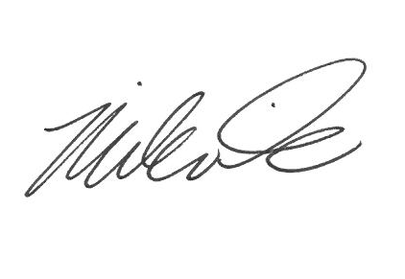
GET OUTDOORS!
The City of Mequon Parks and Open Space Board is pleased to present the 2022 Annual Report. This report provides a high-level overview of participation and many of the division’s most significant accomplishments during the past year.
Much like 2021 local parks, open spaces continued to see a large increase in use. In 2022, all of the past community pillar events were held once again with no restrictions. New events such as Ozaukee United Ways, Dueling Piano’s fund-raising dinner was held for the first time at Rotary Park!
The Parks also again played host to events, such as the second year of the monthly roving beer garden, Multiple HEAT Baseball summer Tournaments, Bigler Sports Softball Tournament, The Fall Classic North Shore United Soccer Tournament, and two Corporate Picnics.
Gathering on the Green held for (4)days for the first time and the 3rd annual Jewish Food Festival had over (20,000) attendees over the (6) days of the events. The POSB is excited about the future prospect of Mequon and the ever-changing landscape. The Board thinks it will provide a unique opportunity to engage even more users of the Parks and Open Spaces in the future. The POSB remains committed to continuous improvements to the overall experience and satisfaction of our patrons.
The POSB and staff would like to thank the Common Council, stakeholders, and community for the support over the years. We look forward to that continued support.
Thank you, Parks and Forestry Superintendent
Mission Statement
The mission of the Park and Open Space Board and Parks Department is to acquire, improve and maintain the City’s park and open space for the purpose of providing space for active and passive recreational activities, land and water preservation and restoration, and environmental education for its residents.

Slide 3
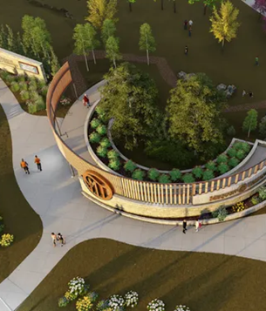

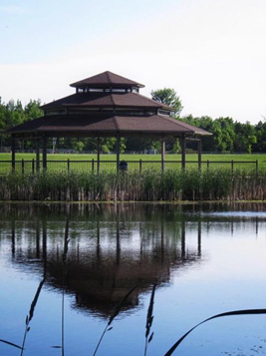
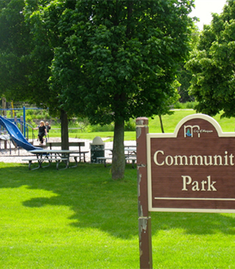

Park and Open Space Board Members
Jason Cain, Chair
Breanne Plier, Vice Chair
Brian Parrish - Aldermanic Rep
Jeffrey Hansher - Alt Aldermanic Rep.
Joe Branch
Peter Bratt
James Lysaught
Anton Usowski
Gerald Vite
David Wolfson
Common Council
Andrew Nerbun - Mayor
Robert Strezylzck
Glenn Bushee
Dale Mayr
Jeffrey Hansher
Mark Gierl
Brian Parrish
Kathleen Schneider
City Administrator
Will Jones

Slide 4
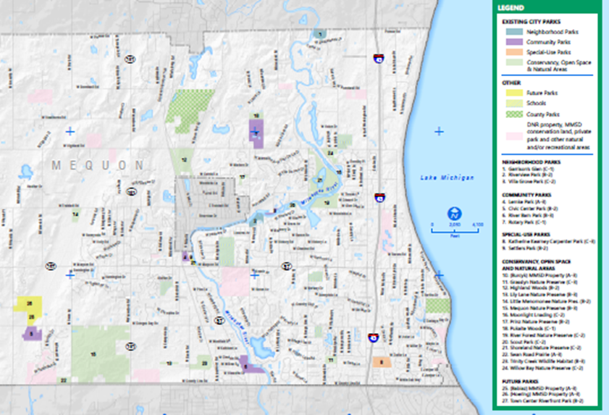
City
of
Mequon
Park System Map

Slide 5
City of Mequon Public
Open Space / Dedicated land

Slide 6
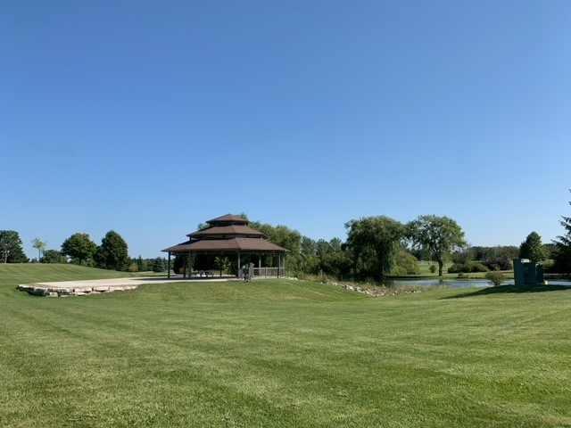
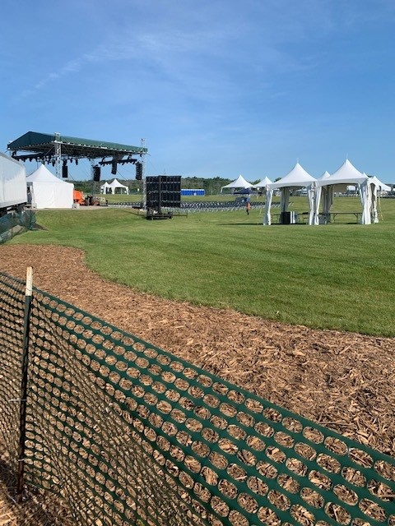
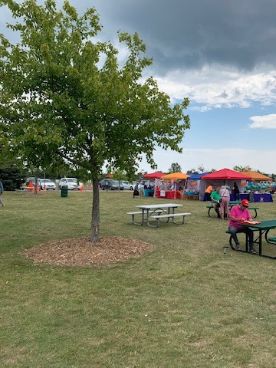
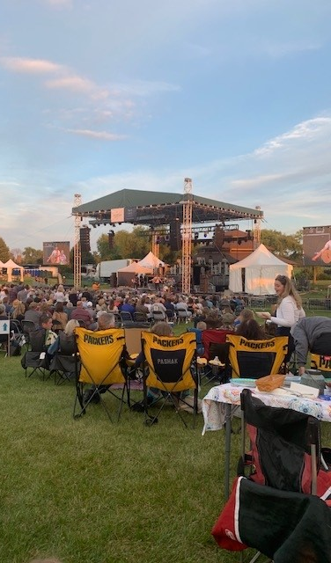

Rentals and income

Slide 7
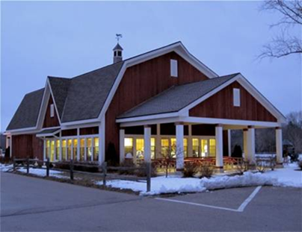
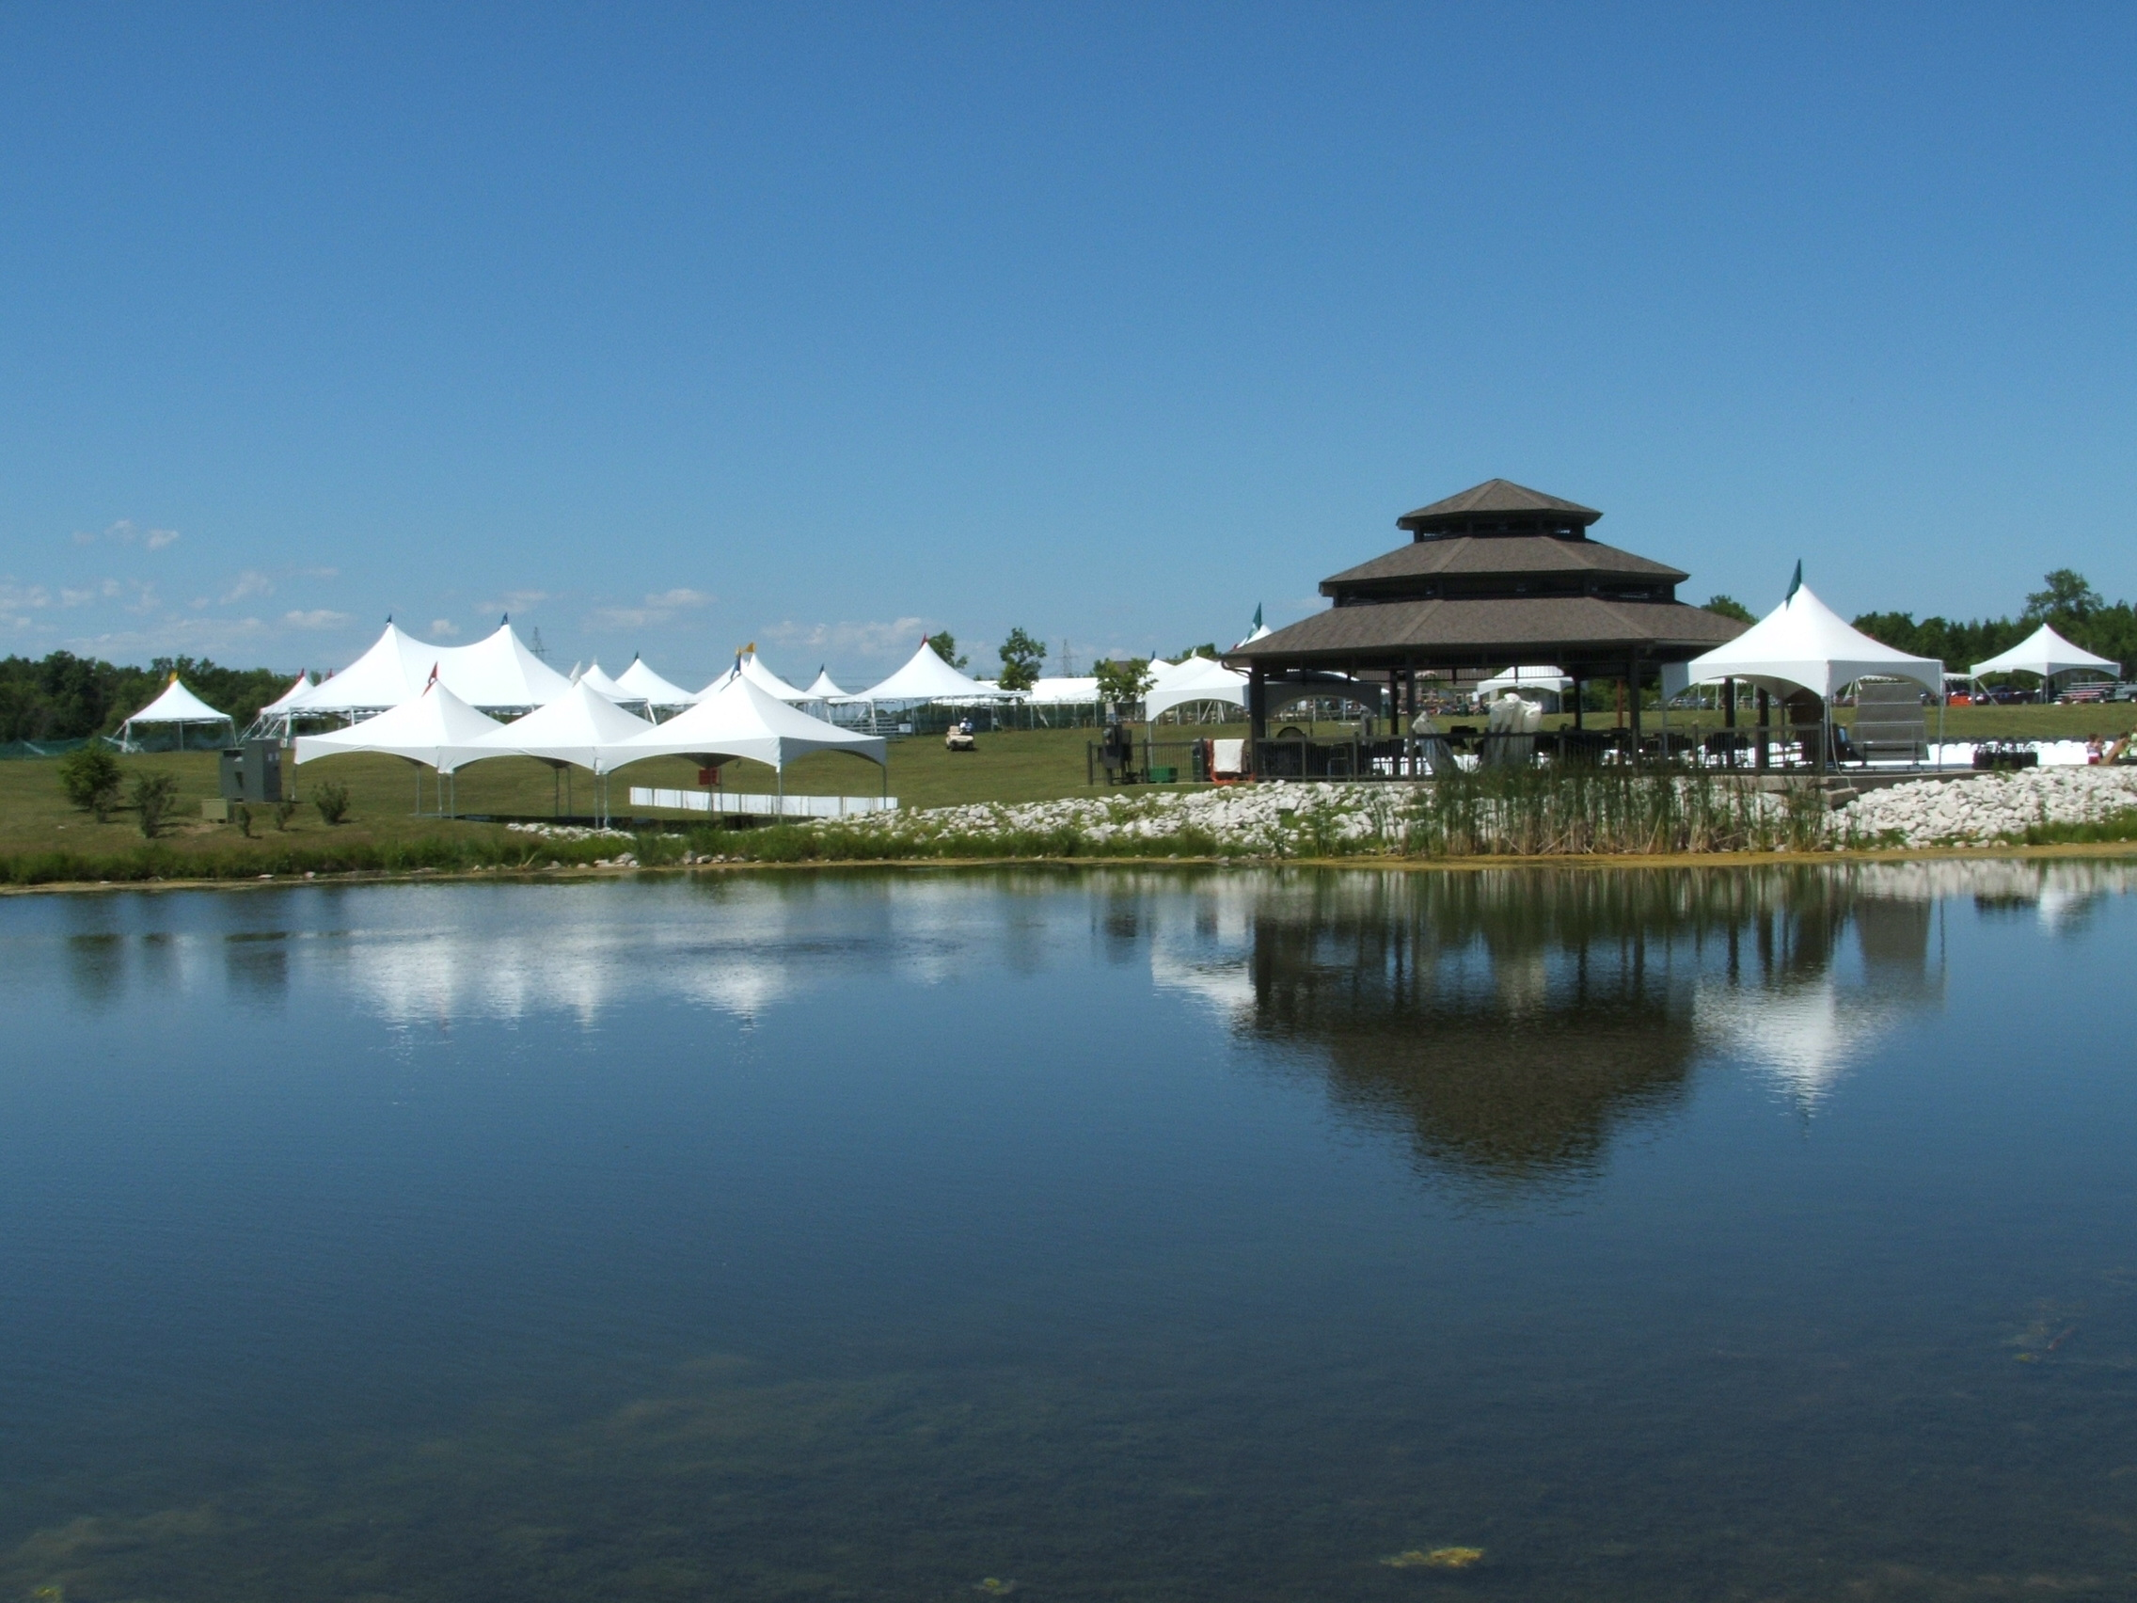
2022 Pavilion and
Sports Rentals
Sports Rentals/ Usage
HEAT Baseball and Softball
  Mayhem in Mequon, Memorial Shootout, Highlander Battle Tournaments
  Round Robins
  Spring, Summer, and Fall Practices
MTLL
  Spring and Summer games and Practices
  Travel Leagues
Ozaukee Lacrosse
  Marquette (Lacrosse Clinics)
Bigler Sports
  Fathers Day Tournament and Spring/Fall Ball
BOSS Baseball
  Spring and Fall
HHS Baseball and Softball
  Spring and Fall
HHS Cross Country
Mequon-Thiensville Middle School Cross Country
  Meets (Rotary)
MATC Softball
  Spring and Fall Ball
Milwaukee Wave
  Summer Camp
North Shore United Soccer
  Spring and Fall
  Tournaments and League/Practices
T-M Twins
  Spring/Summer
Delta Sports Performance
  Fall Ball
Mequon Aviators
  Summer Ball
Cardinal Football
  Summer-Fall
Large Park Events
Jewish Food Festival
Gathering On the Green
North Shore United Spring (3vs3) and Fall Tournaments
Highlander Battle- Baseball Tournament (Heat)
HEAT Baseball Tournament
Bigler Baseball- Father’s Day Tournament
1840 Brewing Traveling Beer Gardens
Perlick Corporate Picnic
KMC Stamping Corporate Picnic

Slide 8
2022, 2021 and 2020 Pavilion Rental
Income Comparison

Slide 9
Percentage of Park Rental use in 2020, 2021 and 2022 from April 1 – October 31

Slide 10
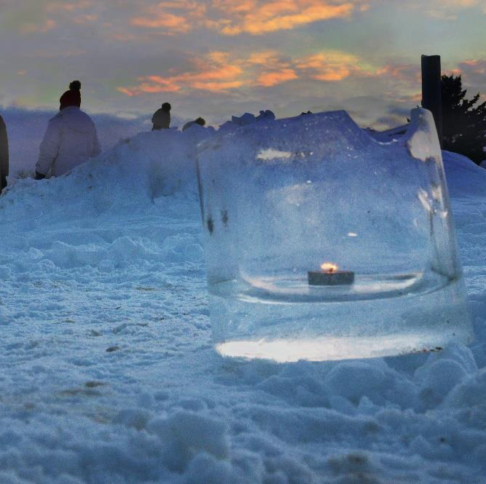
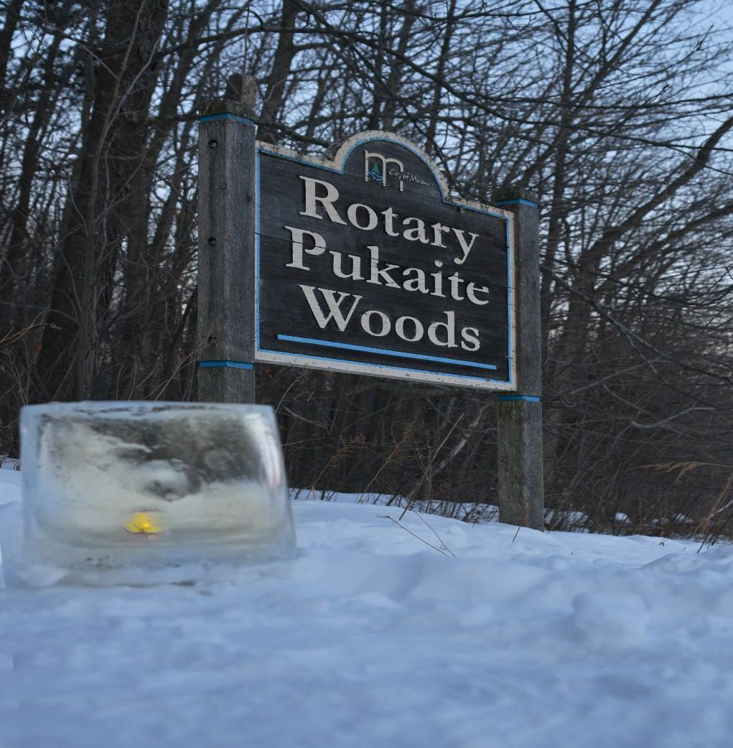
Candlelight walk in Pukaite woods at rotary park
On Saturday February 19, from 4:30 p.m. to 8:00 p.m. Mequon’s Sunrise Rotary Club and the City of Mequon partnered to host the second winter luminary walk at Rotary Park (Pukaite Woods). The walk was held at the northern end of the park and wound its way through Pukaite Woods for approximately one mile. The hike was illuminated by over 200 candlelit ice luminaries, that were made by the Mequon Parks Division and the members and families from Boy Scout Troop 865.
The night walk offered a new perspective of the woods in winter. The ice luminaries and luminary bags were placed every 40 to 50 feet providing a guided path through the dark, while the firepits along the route offered a place to warm up. At the conclusion of the walk Rotarians offered hot coco, warm apple cider, and coffee. Prepackaged smores made by Mequon DPW staff, were offered to attendees as a special treat.
A special thank you goes out to the volunteers from the Rotary Club, Boy Scout Troop 865, Homestead High School students, Concordia University Students, and the City’s Department of Public Works staff for making the event a resounding success!
Staff looks forward to making this an annual event, with plans already in the works for 2023!

Slide 11
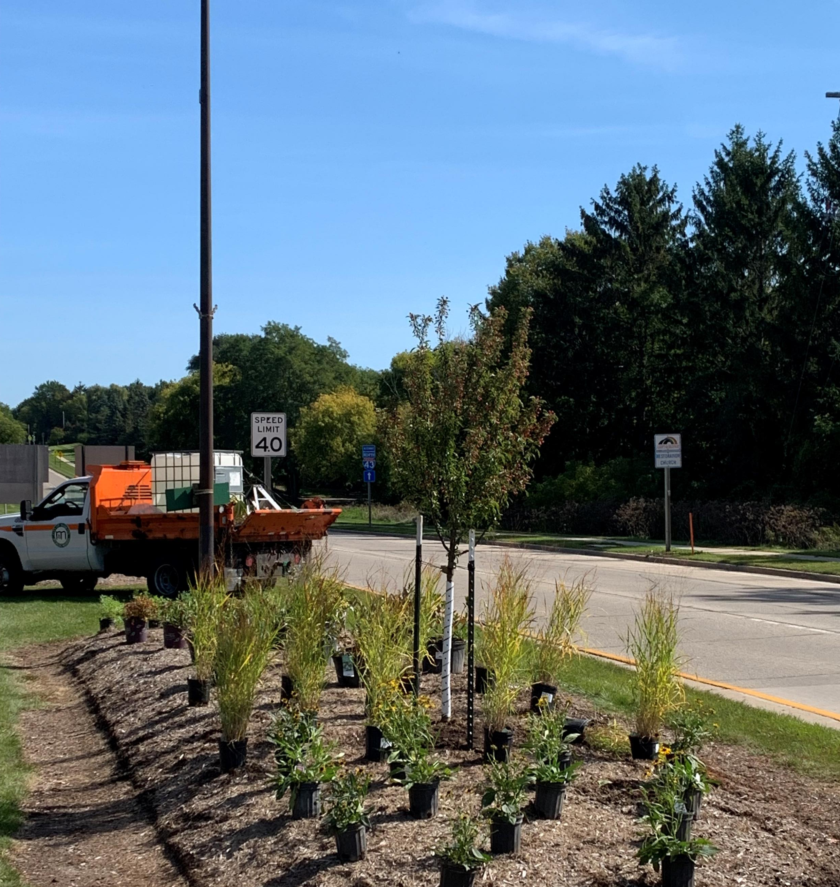
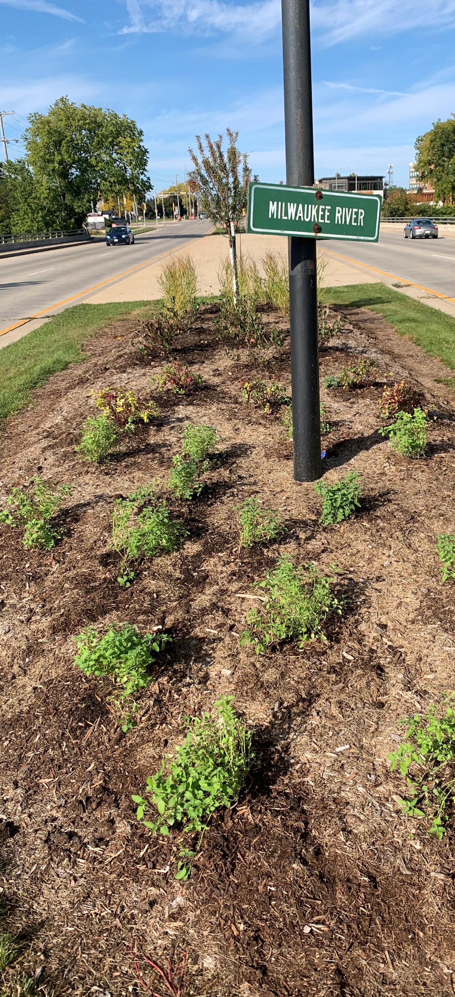
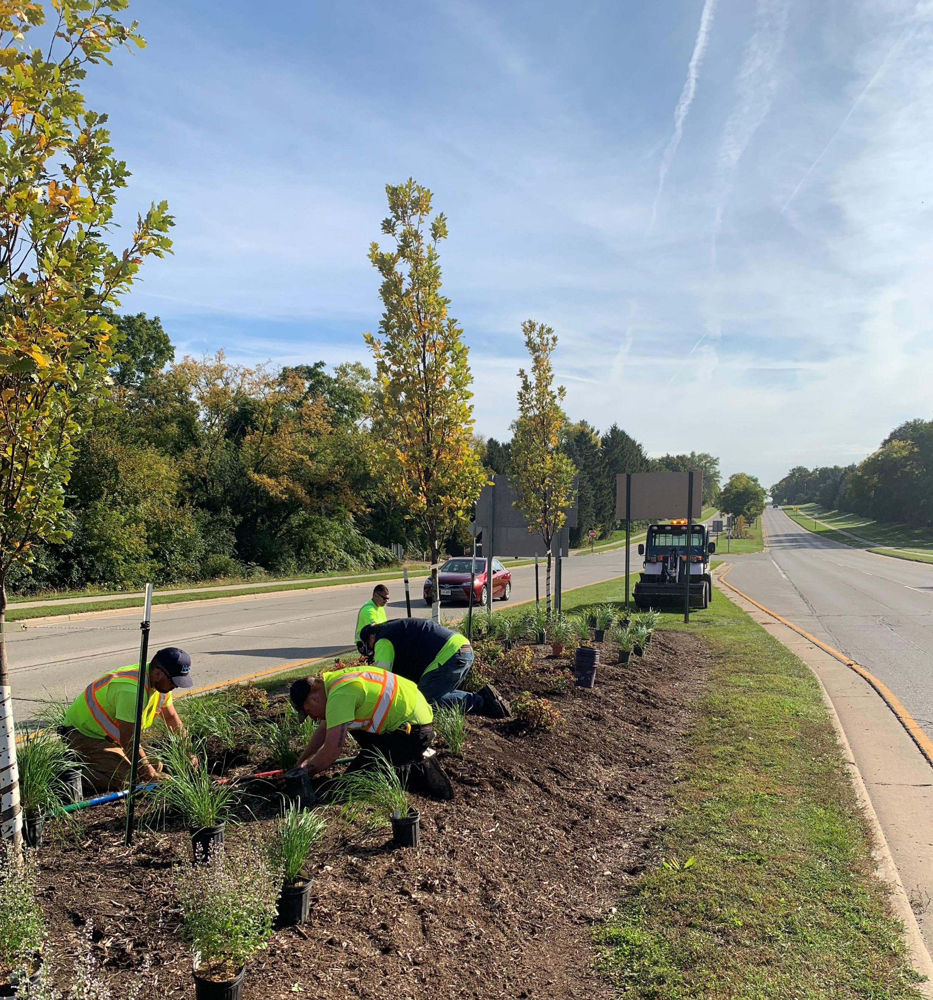
Park services- Maintenance, Beautification, and Support
Operations and Maintenance –
staffing hours dedicated 2022
Facilities - Serviced 7 days a week – for 238 days total from March- November – for an average of 4.0 hours/day = 952 hours.
Off-season Building Operations – November - March - additional 650 hours of pressure washing, scrubbing, painting, cleaning, stripping/waxing, polishing, projects, and fixture replacement
Landscape - cleanups, mulching, planting, watering, pruning, playground chip, brushing, gravel installation, building, spraying, mowing, rolling, aerating, etc.= 4,250 hrs./year
Equipment= 315 hrs./year
Athletic Facilities= 480hrs./year
EAB Removal and Replacement (park) - 300hrs./year
  - Removal 550 ash trees
  - Planted 40 trees
  - Parks impacted in 2022:
  - Riverview, Settlers, Villa Grove, Lemke, River Barn, Community Park, and Katherine Kearney Carpenter Park

Slide 12
2022 Accomplishments
New pier installation at Rotary Park pond Ledge stone (fishing platform) installation at the Rotary Park ponds Bridge Sanding and Refinishing at Rotary Park ponds Forestry Mowing – Highland Woods and Grasslyn Nature Preserve Parking Lot Resurfacing - Community Park/Library Administration of SMB contract for baseball field maintenance - Rennicke, Rotary, River Barn EAB Removal at Villa Grove Park and tree replacement (20 trees) Cleanup, Restoration, and Connection of two new parcels adjacent to the Gateway. Administration of (6) Special Event Agreements, up from (4) in 2021 Installation of AC at River Barn Park Approved Design for Lemke Park Building Administered special event agreement to allow goats to feed on invasive species in Rotary Park 20 tons of gravel installed at Rotary Park to resurface trails in Pukaite Woods (donated by Rotary Club member Ed Morty) Successful administration of multiple sport season’s Administration of two Dedication/Donation agreements for ballfield fences at River Barn Park and Dugouts at both River Barn and Rotary Parks Administration of Special Event Agreement to allow for second year of Beer Garden Events in Mequon Parks Implementation of goals and objectives as outlined by the Park and Open Space Plan Reprioritization of CIP list for 2022 projects by the Park and Open Space Board Creation of the third Park and Open Space Annual Report Mequon Road Median Planting

Slide 13
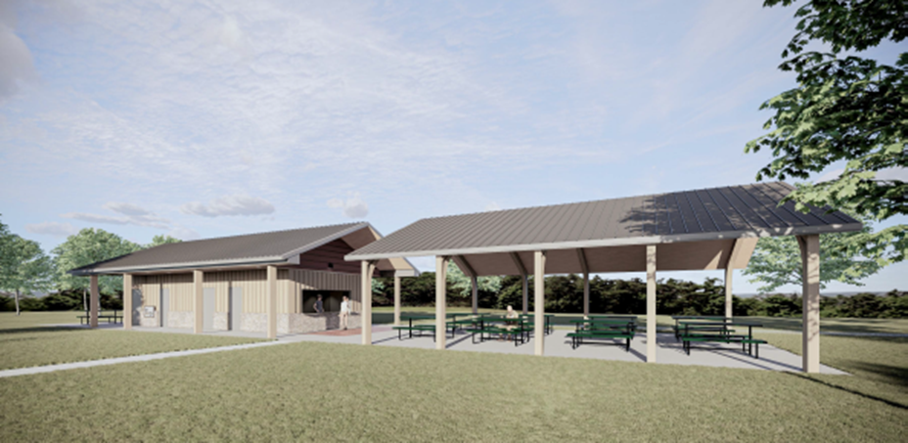
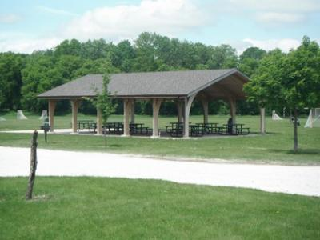
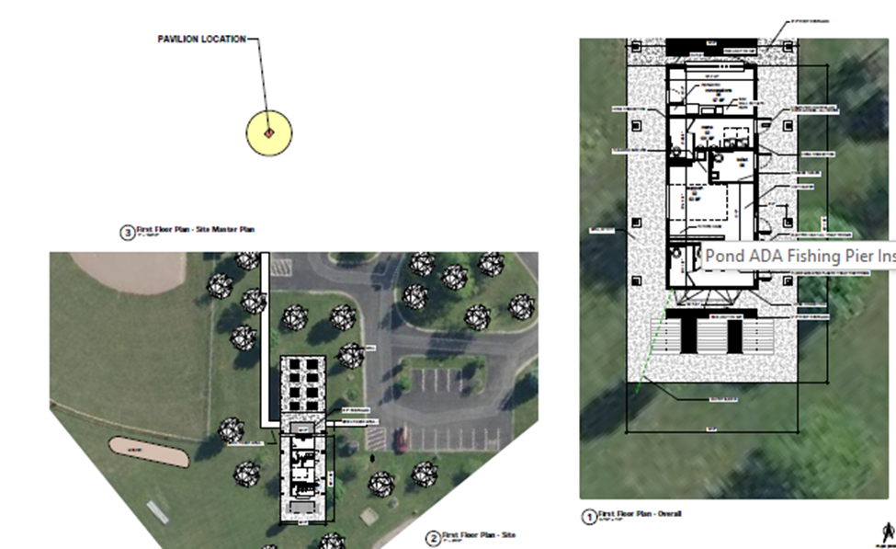
Lemke Park Restroom, Concession, and storage Building Design

Slide 14
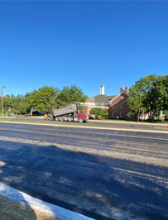
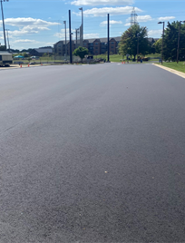
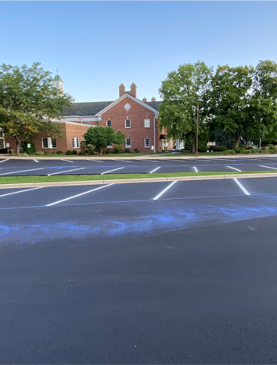
Community park repaving project

Slide 15
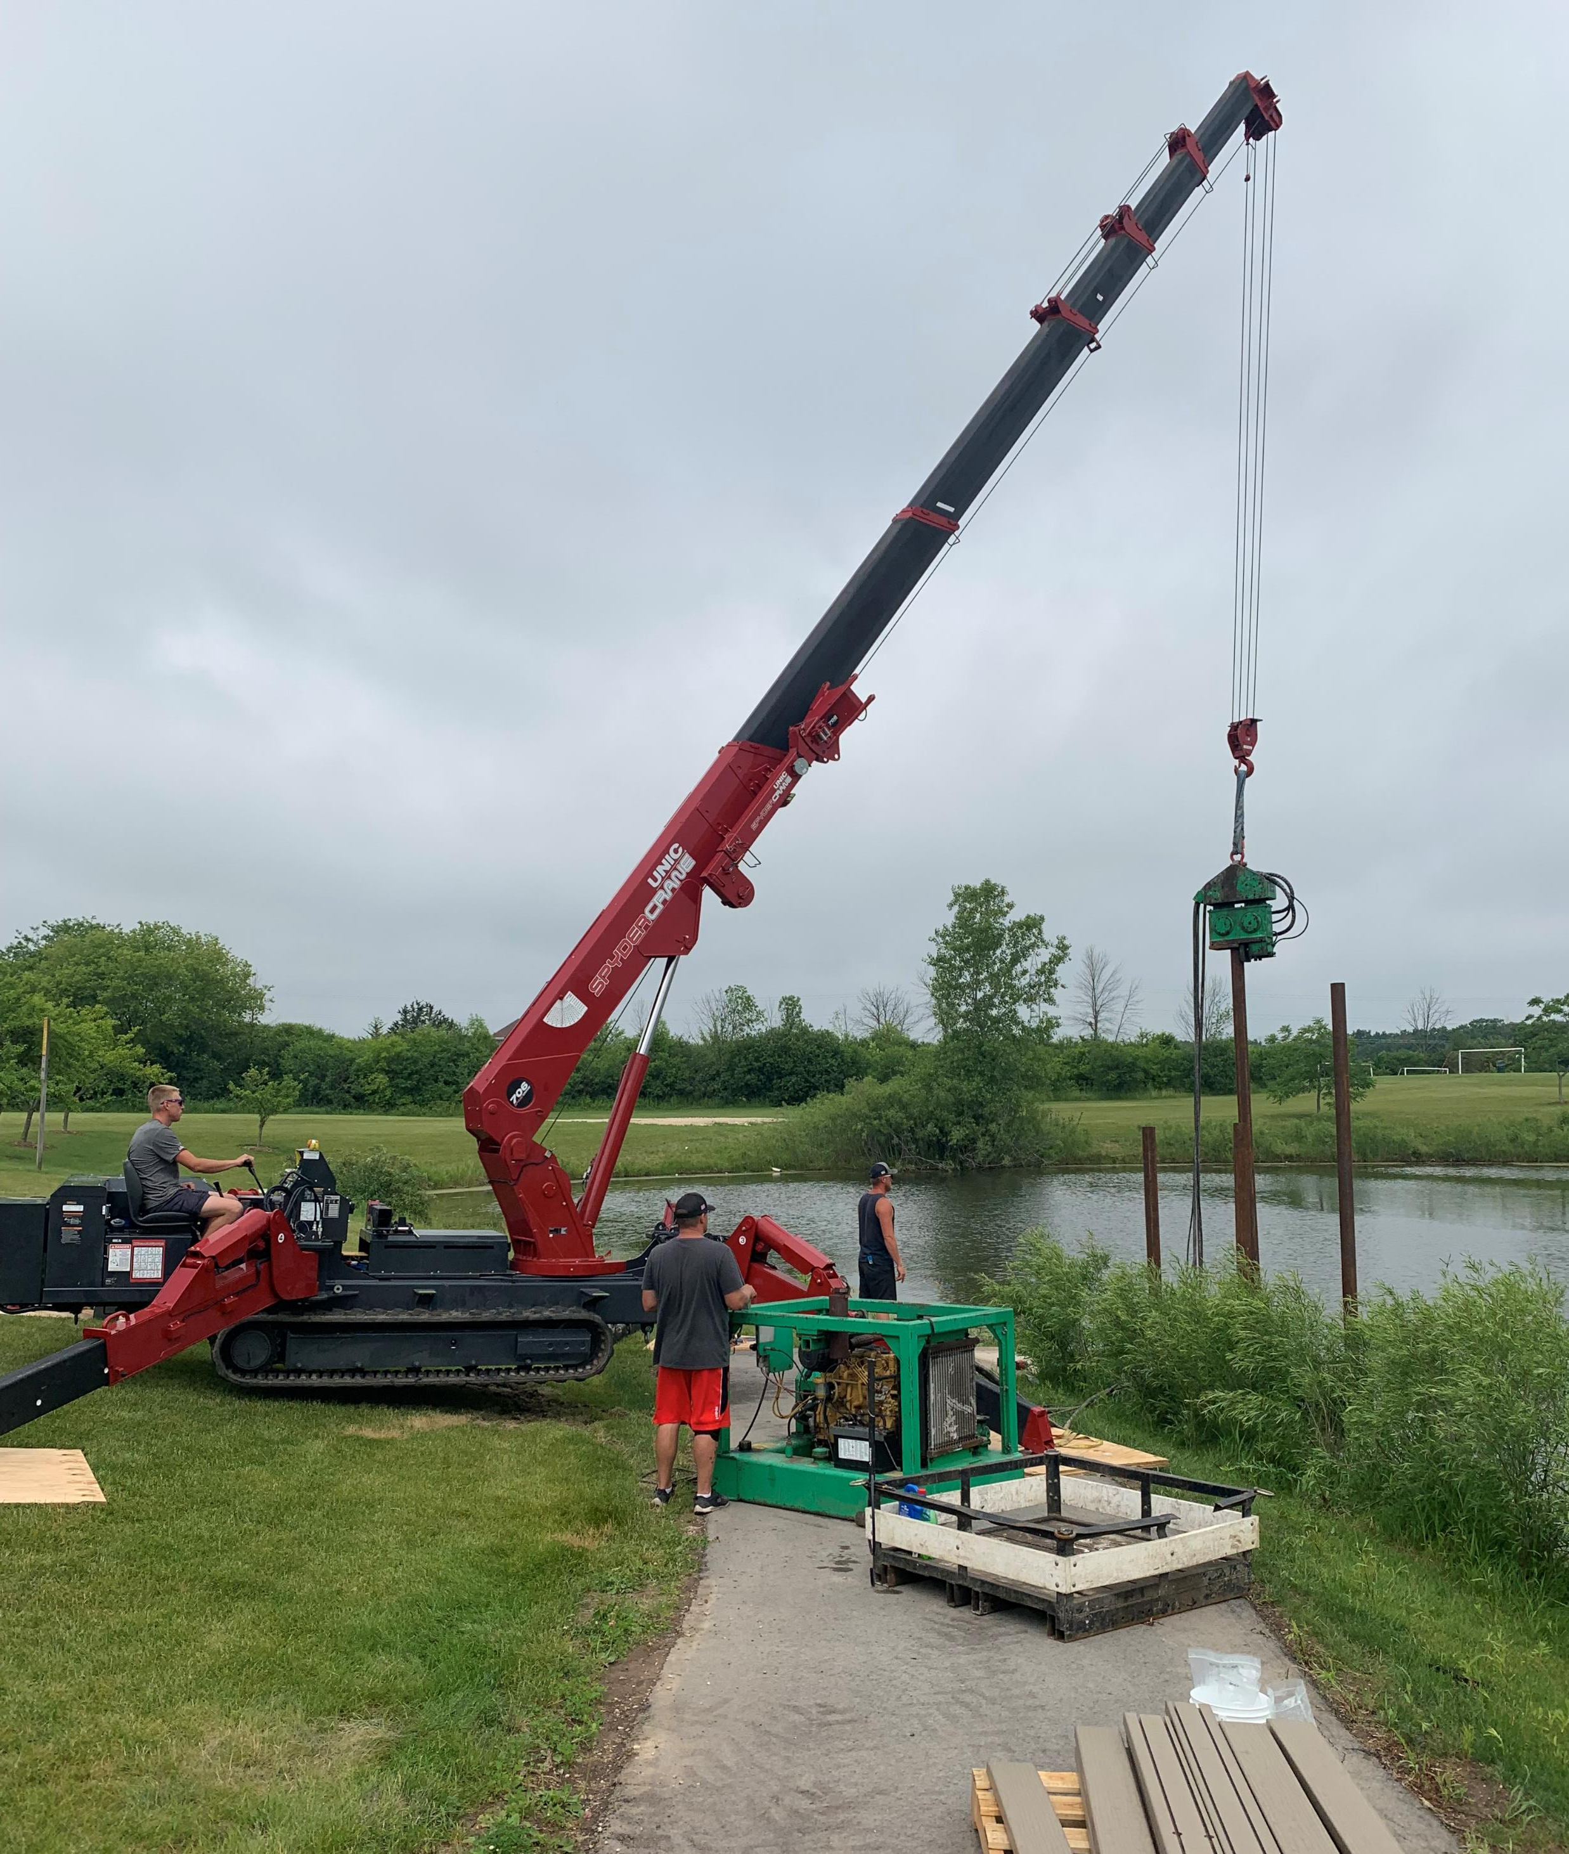
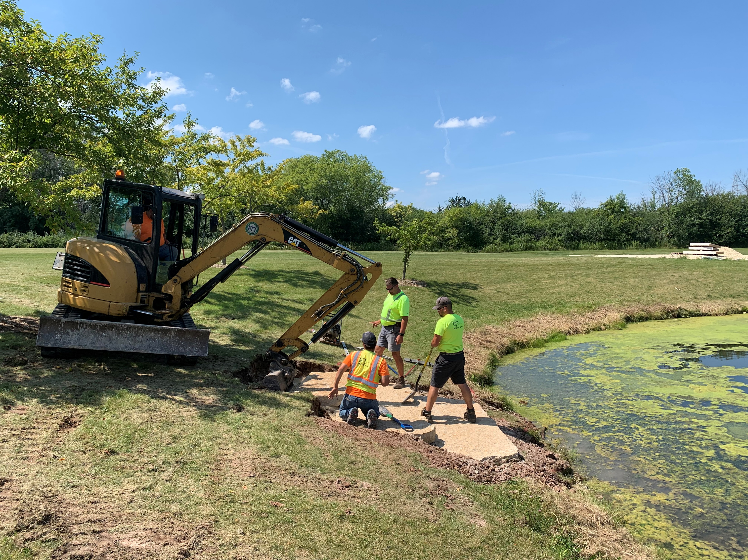
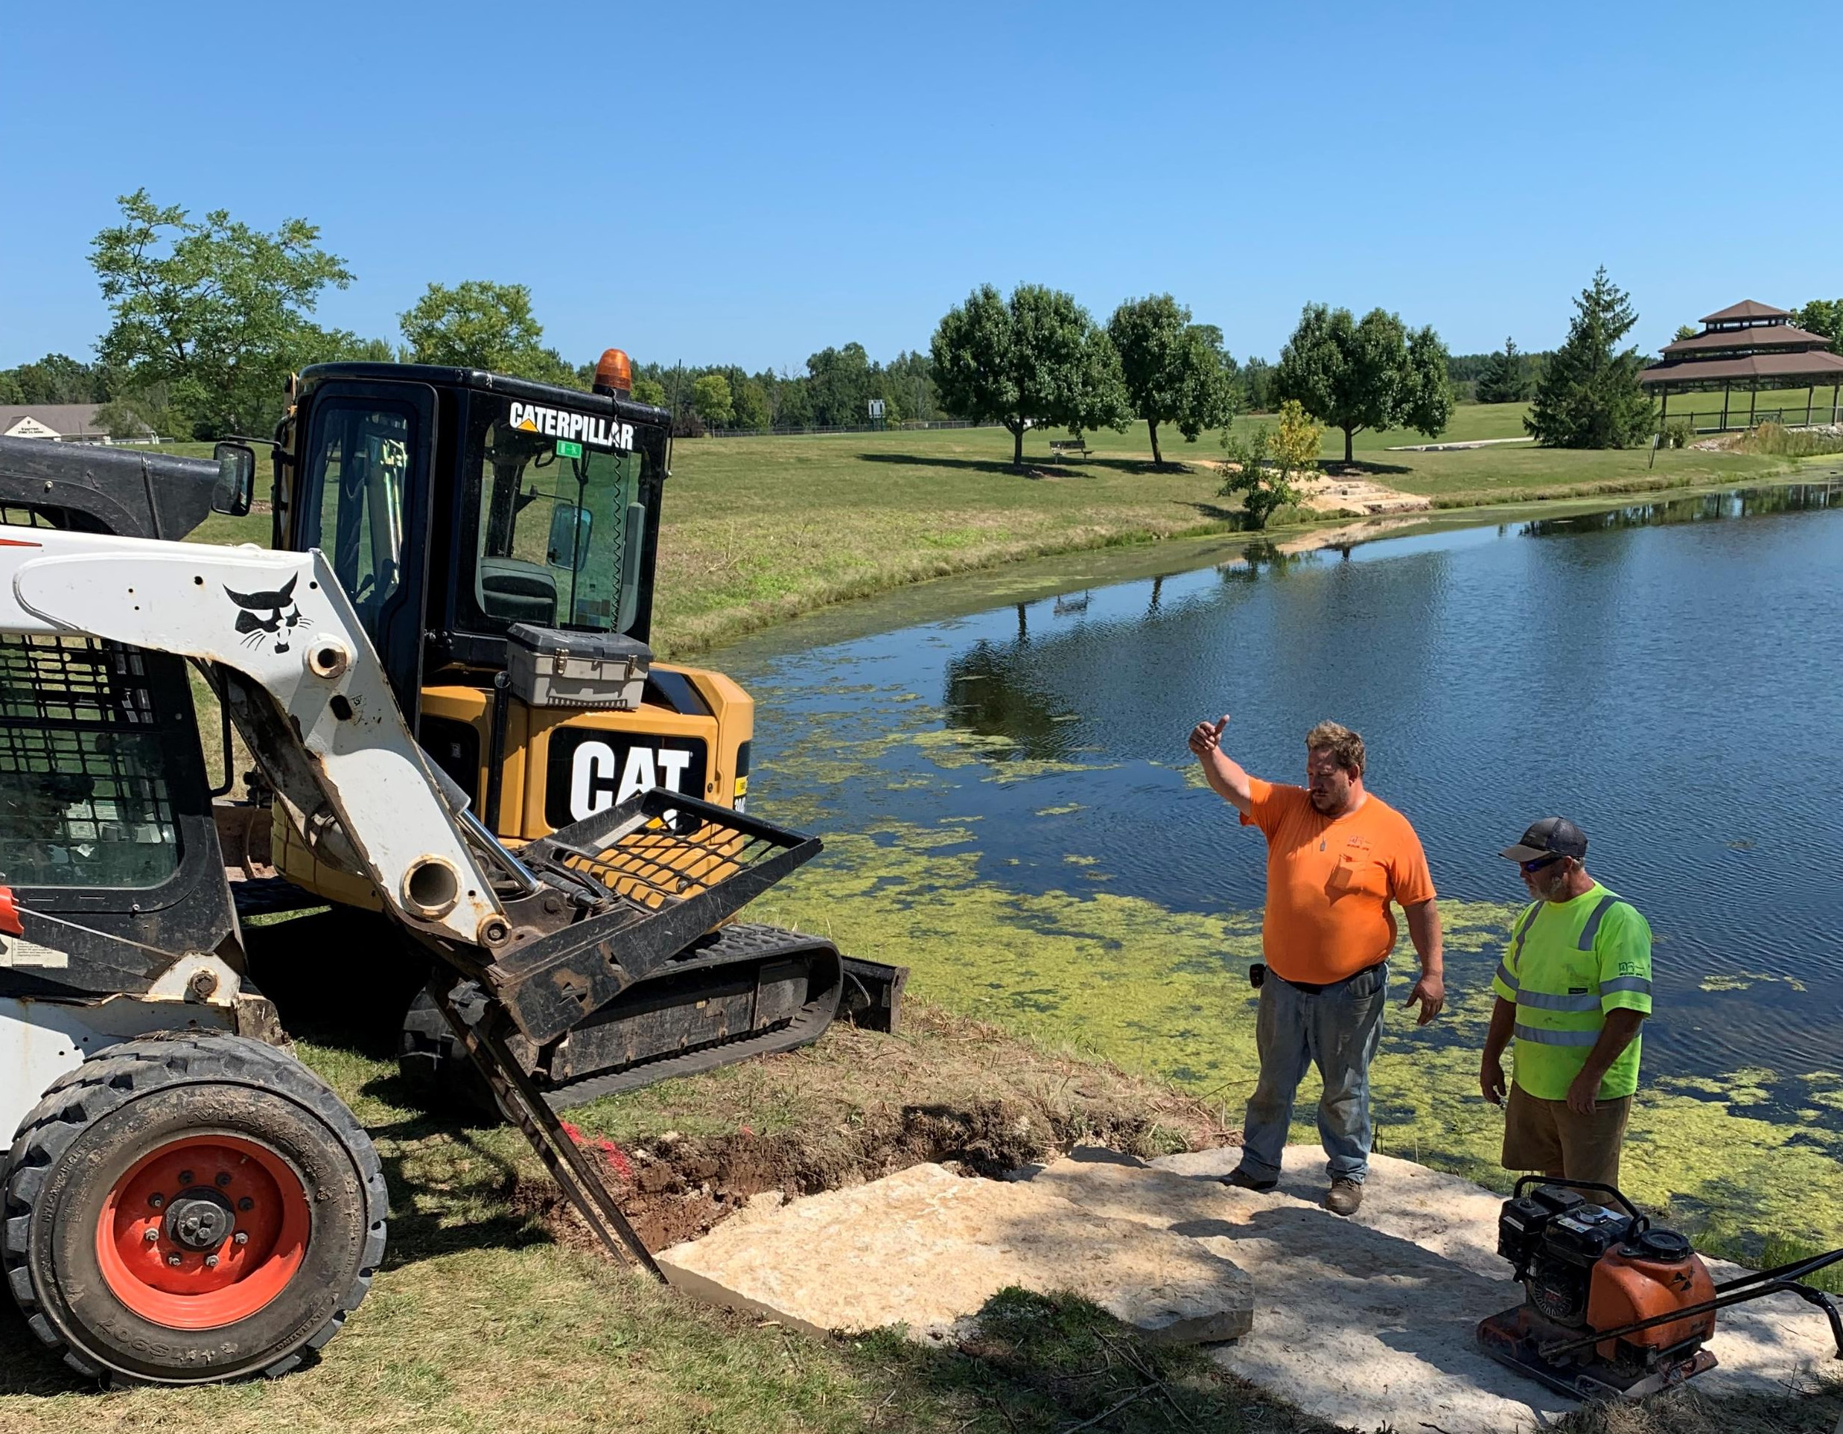
Rotary Park Pond, ADA Fishing Pier Installation – July/Aug. 22’

Slide 16
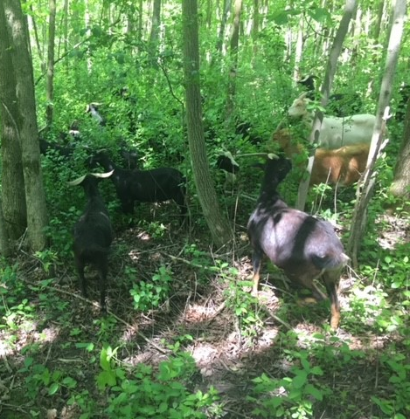
2022 Volunteer Projects
The Park and Open Space Division logged 1,500 hours of volunteer time during 2022 from the following groups:
Grasslyn Nature Preserve – Trail maintenance, Invasive removal, and planting
Highland Woods – Trail maintenance
River Barn Park Eagle Scout Project – Troop 865 – Installation of Canoe/Kayak launch
Rotary Club/ Pukaite Woods- Invasive Removal Utilizing Goats
Rotary Park Eagle Scout Project - Troop 865 Restoration and Refinishing of Rotary Park Pond Bridge
Rotary Club, OWLT, Pack 865, Concordia – Invasive removal, Candlelight Walk
Rennicke and Schmit – Field Restoration Workday – Spring/Fall
Garbage/Clean-up Day – Homestead Students

Slide 17
Completed 2022 capital improvement projects
Rotary Park Pond - ADA Fishing Pier Installation
River Barn Park - AC Installation
Lemke Park – Design for Facility
Community Park, Library, Pool - Parking Lot Installation
River Barn Park
- Outfield fence installation
- Dugout installation
Rotary Park - dugout installation

Slide 18
2023 Proposed Capital Project list
Lemke Park
Restroom, Concession, and Storage Facility Construction
Rotary Park
Basketball Court resurfacing with new fencing and Pickleball
Rotary Park
Water Softeners
River Barn Park
LED Light conversion
Parks Buildings (3)
Install (new) Drinking Fountains

Slide 19
Future Capital Improvement Project(CIP) Priority List
Sources of funding to be determined

Slide 20
Thank you to our community partners
Mequon Community Foundation
B.A.T.S Academy
BOSS Baseball
Bigler Sports
MATC Softball
Cardinal Football
North Shore United Soccer
Pommerntag
Gathering on the Green
Milwaukee Wave Soccer
M-T Twins
Rotary Club
Lions Club
HHS, Mequon-Thiensville School District
Delta Sports Performance
Ozaukee Washington Land Trust
Ozaukee Lacrosse
Steffen/Lakeshore Middle School Cross Country
Boy Scout Troop 865
1840 Brewing
Rotary Club Foundation
Mequon Thiensville Little League
Mequon HEAT baseball & softball

