Slide 1
Sewer Lateral and Mainline Rehabilitation Through Lining
Mark Norgaard
Technical Sales Representative
LMK Technologies

Slide 2
Discussion Points
Why Is Your Sewer Pipe Being Lined
How Will It Be Lined
What It Means To You

Slide 3
Your Lateral Sewer Line is Part of the Wastewater Collection System
Sewer Mainline
Manhole
Lateral
Connection
Notes:
Because your lateral is part of a wastewater collection system that includes your service and city owned manholes and sewer that has aged, deteriorated and leaks. During wet periods or heavy rainfall events, excessive clear water enters the system through these leaks and overloads the city’s ability to collect and treat the wastewater. This can result in sewer backups in homes, localized flooding, excessive wear on equipment and bypassing untreated wastewater into Lake Michigan. The conclusion is all leaking parts of the system, including private services must be sealed

Slide 4
All Leaking parts of the system Must be Rehabilitated and Sealed
The public system which includes the mainline and manholes has been or is in process of being rehabilitated
The lateral pipe that connects the home to the public system also need to be rehabilitated and then sealed at the connection
Notes:
Why lining? Because lining, using well established trenchless technologies, is seen to be a preferred alternative to digging and replacing individual sewer services. Lining can significantly reduce impacts associated with repairing city streets and sidewalks, removing trees, restoring landscaping, driveways, lawns and disruption of traffic

Slide 5
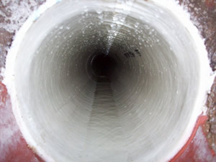
Rehabilitation – What Does it Mean?
Can Dig and Replace the Pipe
Or
Line with a Trenchless Cured-in-Place Pipe (CIPP) process
Quick and cost effective
Landscapes are preserved
Trees do not need to remove
Doesn’t affect traffic
Accepted technology for over 30 years
Creates a New Pipe Within A Pipe
Notes:
Why lining? Because lining, using well established trenchless technologies, is seen to be a preferred alternative to digging and replacing individual sewer services. Lining can significantly reduce impacts associated with repairing city streets and sidewalks, removing trees, restoring landscaping, driveways, lawns and disruption of traffic

Slide 6
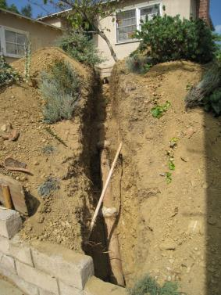
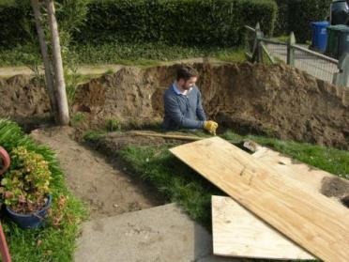
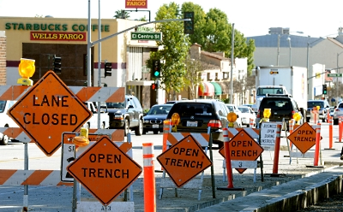
Digging and Replacing Involves:

Slide 7
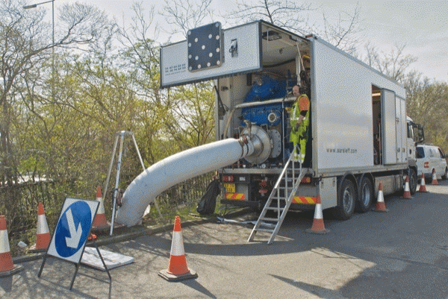
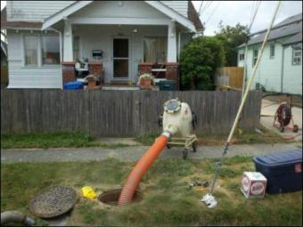
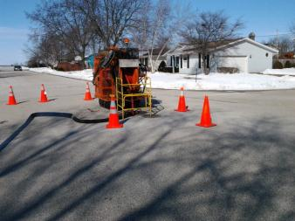
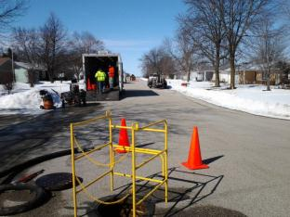
Trenchless Lining Involves:

Slide 8
Failing Mainline Pipes

Slide 9
Mainline Lining Only

Slide 10
Mainline Lining Only Video

Slide 11
Completely Sealed System

Slide 12
Discussion Points
Why Is Your Sewer Pipe Being Lined
How Will It Be Lined
What It Means To You

Slide 13
Lining Process
Basic components of T-Liner® Lining System
Tube and Sheet
Felt mat liner
Bladder which is removed after curing
Hydrophilic Gasket Sealing (Insignia™ Products)
Thermoset polyester resin
Installed via an Inversion Process
Cured with steam in approximately 30-60 minutes
Notes:
The standard industry practice for lining sewer pipes involves a process called inversion, were a polyester felt liner is saturated with resin inside a clear plastic bladder tube and the inverted or turned inside out in the sewer pipe using controlled air pressure. The resin soaked liner, which started out inside the plastic bladder, ends up outside of the bladder while the bladder continues to inflate inside the liner and pressing it out against the host pipe. When the liner is properly position, steam is then introduced into the inflated bladder to cure the resin and in 30 minutes the lined pipe will be back in service.

Slide 14
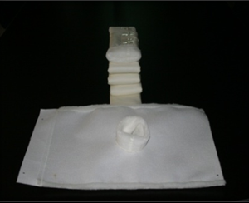
Tube and Sheet

Slide 15
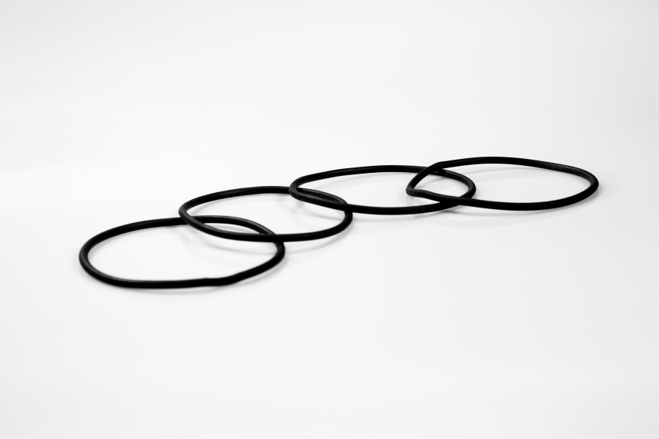
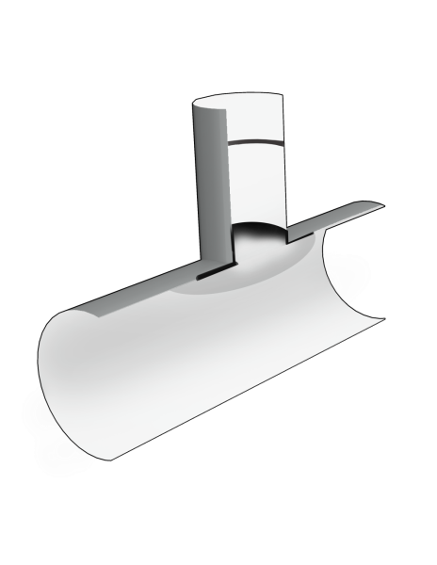
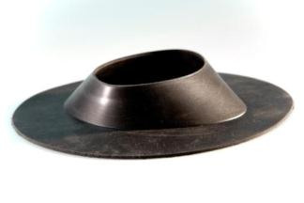
Gasket Sealing Technology
O-Ring
Hydro Hat
Neoprene rubber swells with water contact creating a water-tight seal. Even after 10,000 hours of cycling wet to dry to wet, the water tight seal is maintained.

Slide 16
Adding the Resin

Slide 17
Loading the Launcher

Slide 18
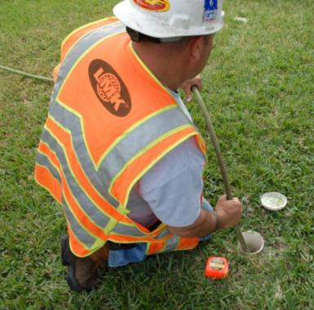
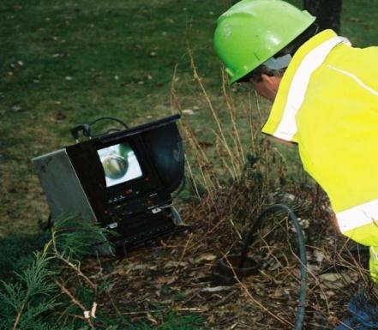
Positioning the camera

Slide 19
Installing the Liner At the Connection

Slide 20
Discussion Points
Why Is Your Sewer Pipe Being Lined
How Will It Be Lined
What It Means To You

Slide 21
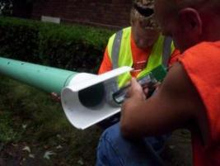
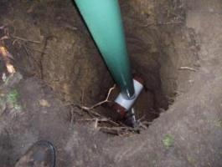
Step 1 - Clean Out Installation
Cleanout will be installed in your yard in a suitable location
20 inch diameter hole excavated to depth of service line
PVC saddle and riser pipe are attached to service line
The excavation hole backfilled and top 2 feet filled with top soil
Sod replaced and cleanout cap installed
60 – 90 minutes
Notes:
The first step is installing a cleanout in your yard in a location that satisfies both the you and meets the project’s needs. The hole for the cleanout will be 20 inches in diameter and dug to the depth of your service by means of vacuum excavation. A PVC saddle and riser pipe will be attached to you service line. The hole will then be backfilled and compacted to prevent the soil from settling. The top 18 inches of the excavation will be filled with topsoil and the two foot by two foot sod square scraped prior to excavation will be replaced. Except for the cleanout cap flush with the ground surface, the goal is to be in and out of your yard without noticeable change. The process will take 60 to 90 minutes.

Slide 22
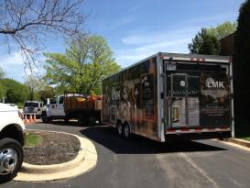
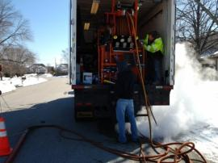
Step 2 - Equipment Set Up
Per project plan schedule crew arrives to set up equipment and begin installation
Truck with steam generator, air compressor and other equipment
Cart with 5-Line machine which moves and positions lining equipment
8 ft x 30 ft work trailer used to store and prep materials
One to two pick up trucks
Four man crew
Notes:
At some point after the cleanouts are installed, and depending on how the contractor plans his schedule, equipment for installing the liners will arrive. It will consist of a truck with a steam generator, air compressor and other equipment, a cart unit called a 5-line machine used to move and position lining equipment, a 8 by 30 foot work trailer used to store and prep materials and one to two pick-up trucks. Crews will generally consist of four technicians.

Slide 23
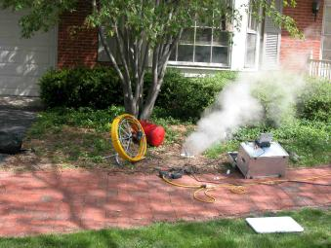
Step 3 - Installation of Liner
At your house
Two hours per sewer lateral line
Steam will be released thru clean-out
Temporary plug is placed in the service line through the clean out
Incidental water is not a problem
Do Not Wash Clothes, Take a Bath, Run Dishwasher, etc. to avoid sewer backup
On your block
Crew will be on street until all houses on the block are completed
Generally 5 houses can be completed in a day
Street closed? Probably not, traffic cones, signage and lighting may be used to alert and direct traffic
When will you know work is completed?
Contractor and city will develop a plan for written and verbal communication with property owners
A site manager will handle day to day contact with property owners
Notes:
How long will it take? Once on site, the installation and steam cure of the liner will take about two hours per sewer service. During that time a temporary plug will be place in your service. During the 2 hour installation, incidental water use should not be a problem but activities like washing clothes, bathing, etc. may cause your sewer to back up. The contractor will do the lining from the city’s sewer in the street. Working between an upstream and a downstream manhole they may be able to line a number individual services without moving their equipment. So, while your service will e back on line in a matter of a couple of hours, you may see contractor equipment on your street for an entire day. To get a rough idea of how long your block will be affected, divide the number of houses on your block by 5 houses per day lined. Not sure what we can do about pictures here. Maybe elevator music, but some good word slides
Will the street be closed? Generally no. A traffic management plan will be developed by the city and contractor. On a typical two way residential street, manholes are located mid road and contractor equipment will block one lane. Again depending on the specifics of the traffic plan, traffic cones, signage and lighting may be used to alert and direct traffic. In all cases, great attention will be given to home owner access and emergency vehicle access.
How will I know when you will line my service? Coordination with the property owner will be priority. The contractor and city will develop a plan for written and verbal communication with property owners. While this plan has yet to be developed, contractors generally expect to have a person on site (typically the site manager) to handle day to day contact with property owners.
How long will it take? Once on site, the installation and steam cure of the liner will take about two hours per sewer service. During that time a temporary plug will be place in your service. During the 2 hour installation, incidental water use should not be a problem but activities like washing clothes, bathing, etc. may cause your sewer to back up. The contractor will do the lining from the city’s sewer in the street. Working between an upstream and a downstream manhole they may be able to line a number individual services without moving their equipment. So, while your service will e back on line in a matter of a couple of hours, you may see contractor equipment on your street for an entire day. To get a rough idea of how long your block will be affected, divide the number of houses on your block by 5 houses per day lined. Not sure what we can do about pictures here. Maybe elevator music, but some good word slides
Will the street be closed? Generally no. A traffic management plan will be developed by the city and contractor. On a typical two way residential street, manholes are located mid road and contractor equipment will block one lane. Again depending on the specifics of the traffic plan, traffic cones, signage and lighting may be used to alert and direct traffic. In all cases, great attention will be given to home owner access and emergency vehicle access.
How will I know when you will line my service? Coordination with the property owner will be priority. The contractor and city will develop a plan for written and verbal communication with property owners. While this plan has yet to be developed, contractors generally expect to have a person on site (typically the site manager) to handle day to day contact with property owners.
How long will it take? Once on site, the installation and steam cure of the liner will take about two hours per sewer service. During that time a temporary plug will be place in your service. During the 2 hour installation, incidental water use should not be a problem but activities like washing clothes, bathing, etc. may cause your sewer to back up. The contractor will do the lining from the city’s sewer in the street. Working between an upstream and a downstream manhole they may be able to line a number individual services without moving their equipment. So, while your service will e back on line in a matter of a couple of hours, you may see contractor equipment on your street for an entire day. To get a rough idea of how long your block will be affected, divide the number of houses on your block by 5 houses per day lined. Not sure what we can do about pictures here. Maybe elevator music, but some good word slides
Will the street be closed? Generally no. A traffic management plan will be developed by the city and contractor. On a typical two way residential street, manholes are located mid road and contractor equipment will block one lane. Again depending on the specifics of the traffic plan, traffic cones, signage and lighting may be used to alert and direct traffic. In all cases, great attention will be given to home owner access and emergency vehicle access.
How will I know when you will line my service? Coordination with the property owner will be priority. The contractor and city will develop a plan for written and verbal communication with property owners. While this plan has yet to be developed, contractors generally expect to have a person on site (typically the site manager) to handle day to day contact with property owners.
How long will it take? Once on site, the installation and steam cure of the liner will take about two hours per sewer service. During that time a temporary plug will be place in your service. During the 2 hour installation, incidental water use should not be a problem but activities like washing clothes, bathing, etc. may cause your sewer to back up. The contractor will do the lining from the city’s sewer in the street. Working between an upstream and a downstream manhole they may be able to line a number individual services without moving their equipment. So, while your service will e back on line in a matter of a couple of hours, you may see contractor equipment on your street for an entire day. To get a rough idea of how long your block will be affected, divide the number of houses on your block by 5 houses per day lined. Not sure what we can do about pictures here. Maybe elevator music, but some good word slides
Will the street be closed? Generally no. A traffic management plan will be developed by the city and contractor. On a typical two way residential street, manholes are located mid road and contractor equipment will block one lane. Again depending on the specifics of the traffic plan, traffic cones, signage and lighting may be used to alert and direct traffic. In all cases, great attention will be given to home owner access and emergency vehicle access.
How will I know when you will line my service? Coordination with the property owner will be priority. The contractor and city will develop a plan for written and verbal communication with property owners. While this plan has yet to be developed, contractors generally expect to have a person on site (typically the site manager) to handle day to day contact with property owners.

Slide 24
Collection System After Mainline and
Main to Lateral Renewal
Client: City of Fort Saskatchewan
#1: 8” X 4” X 101’ 8”
Mainline CIPP Installer: IVIS, Inc.
#2: 8” X 4” X 90’
Lateral CIPP Installer: IVIS, Inc.

Slide 25
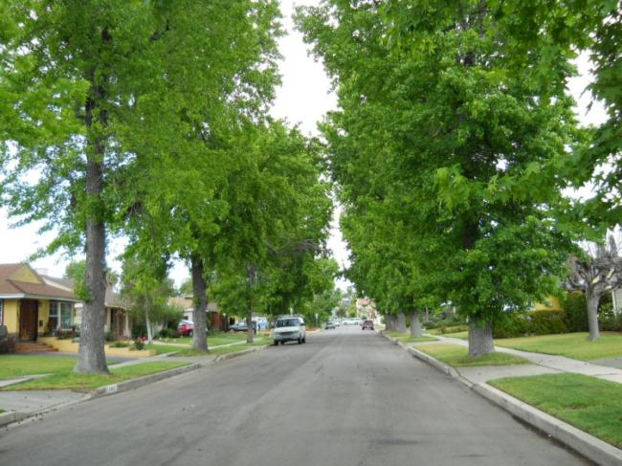
Finished Installation

Slide 26
Questions?

